Slide 1
Welcome to 3rd Grade
3rd grade team: - Matt Fisher
Whitney Hamlin
Nicole Gutneyer
Alicia Polston
Mr. Fisher & Mrs. Hamlin

Slide 2
Video:

Slide 3
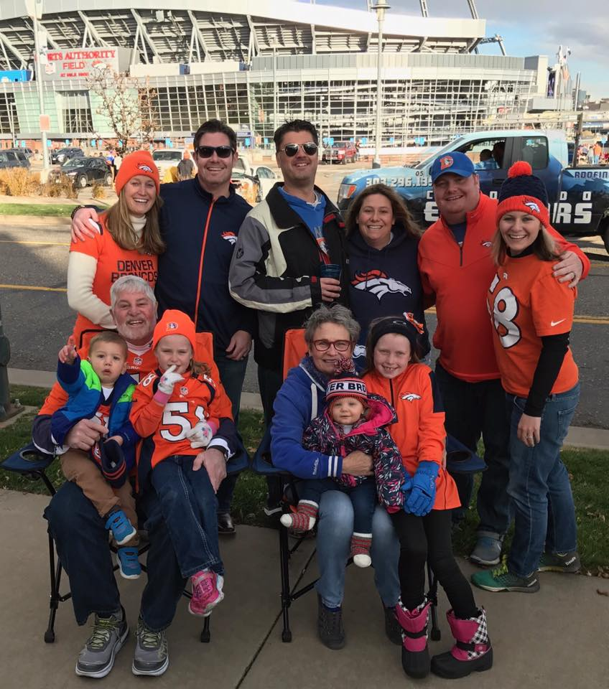
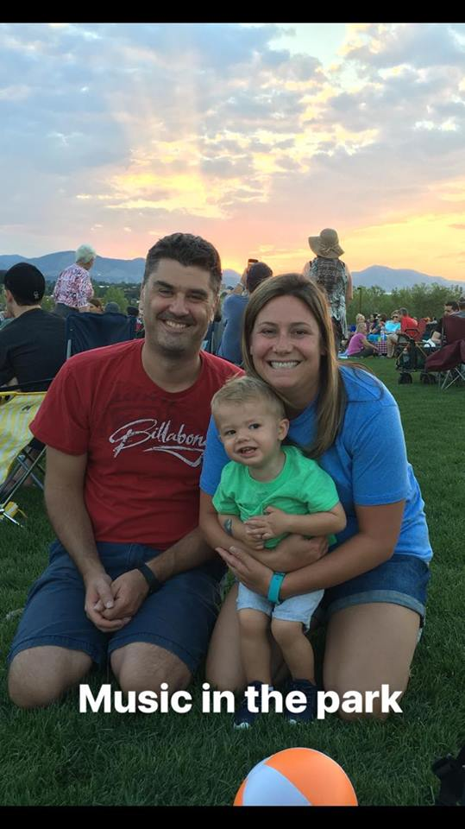
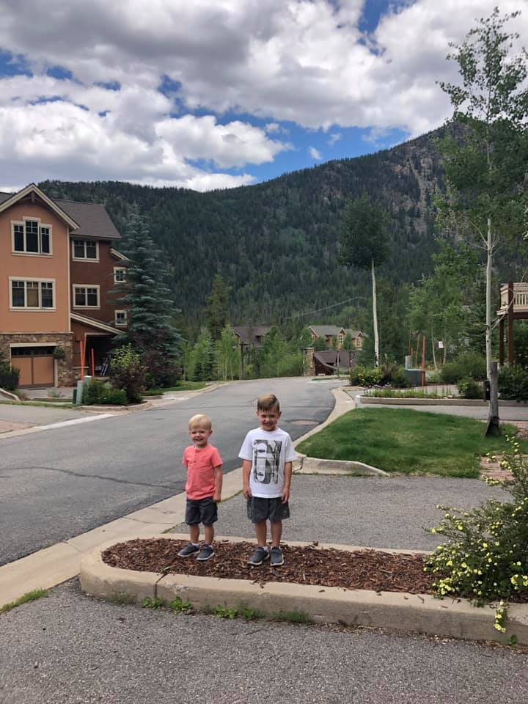
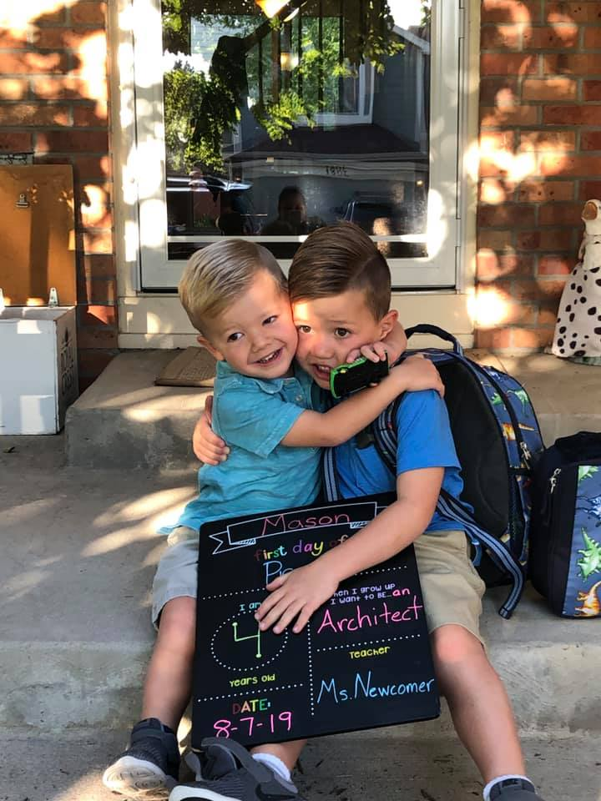
Whitney Hamlin
8th year at Brown International,12th year teaching overall,
I’ve taught 1st grade, Mild/Moderate SpEd, Affective Needs and 3rd grade
Mother of two fabulous boys, Mason(4), Charlie(2)
Wife to an incredibly loving and supportive husband for over 6 years.
Broncos enthusiast

Slide 4
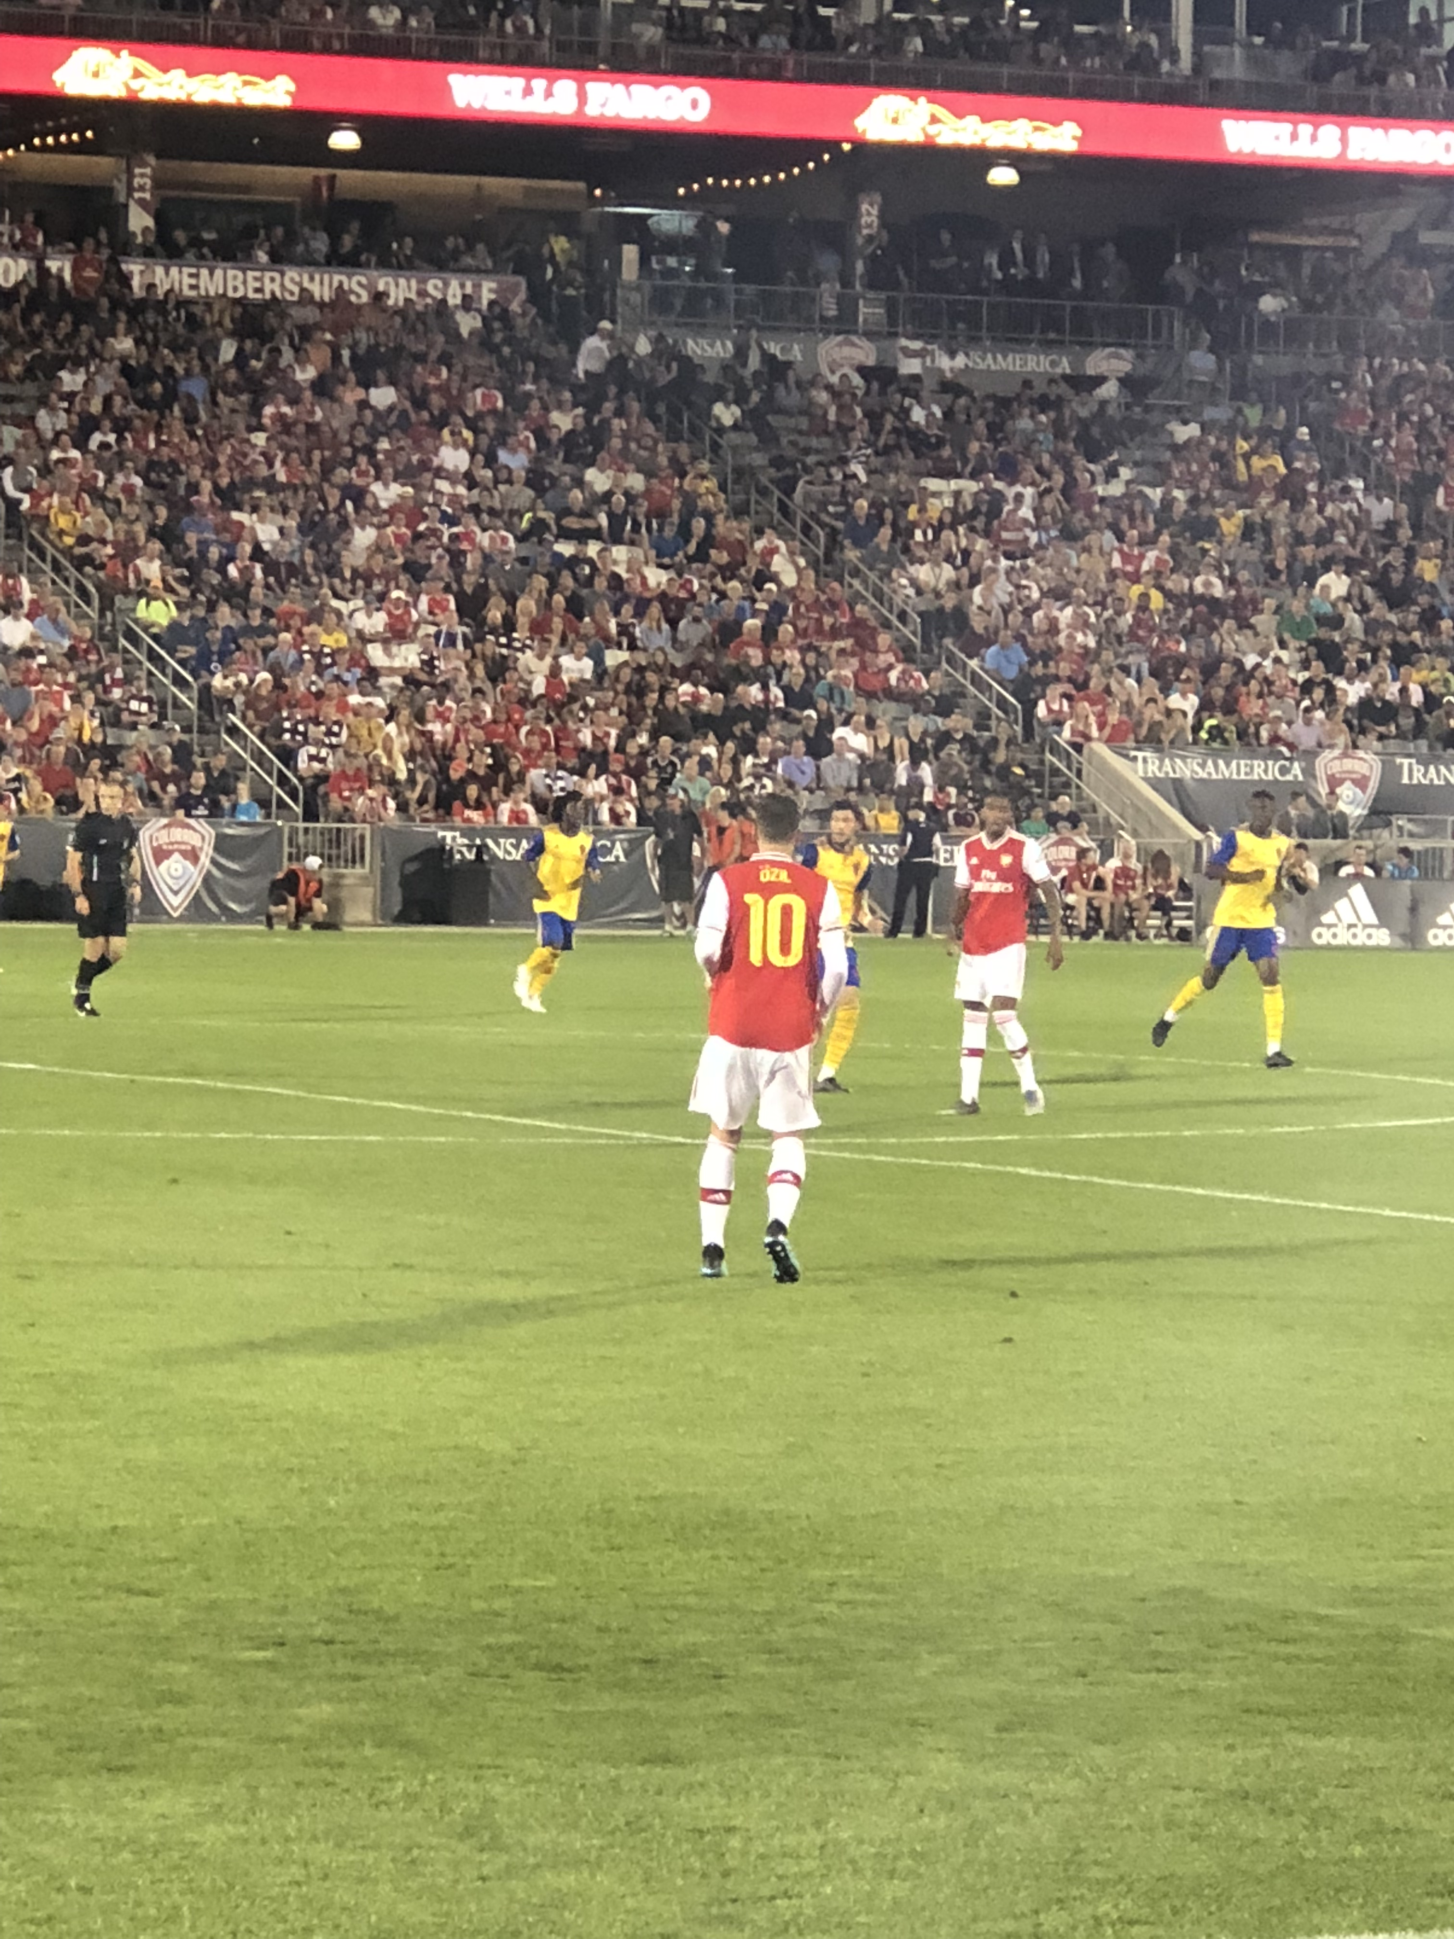
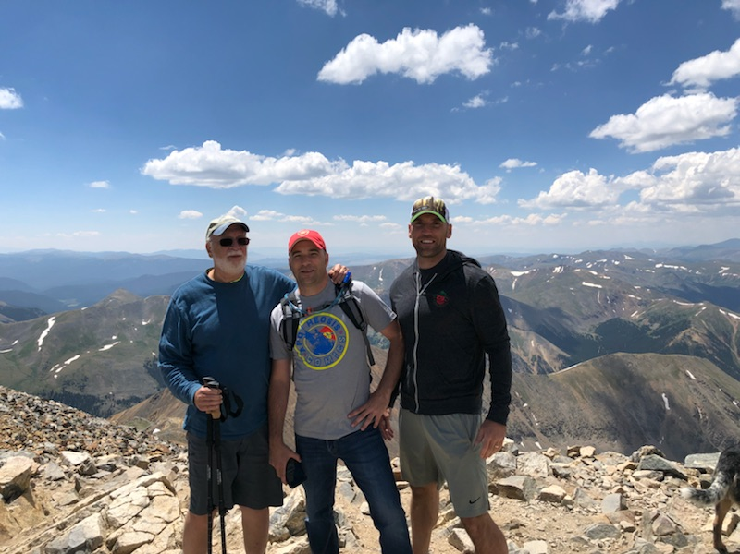
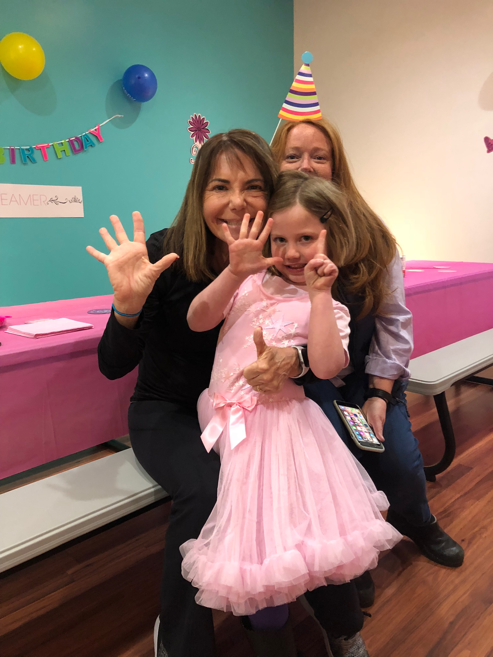
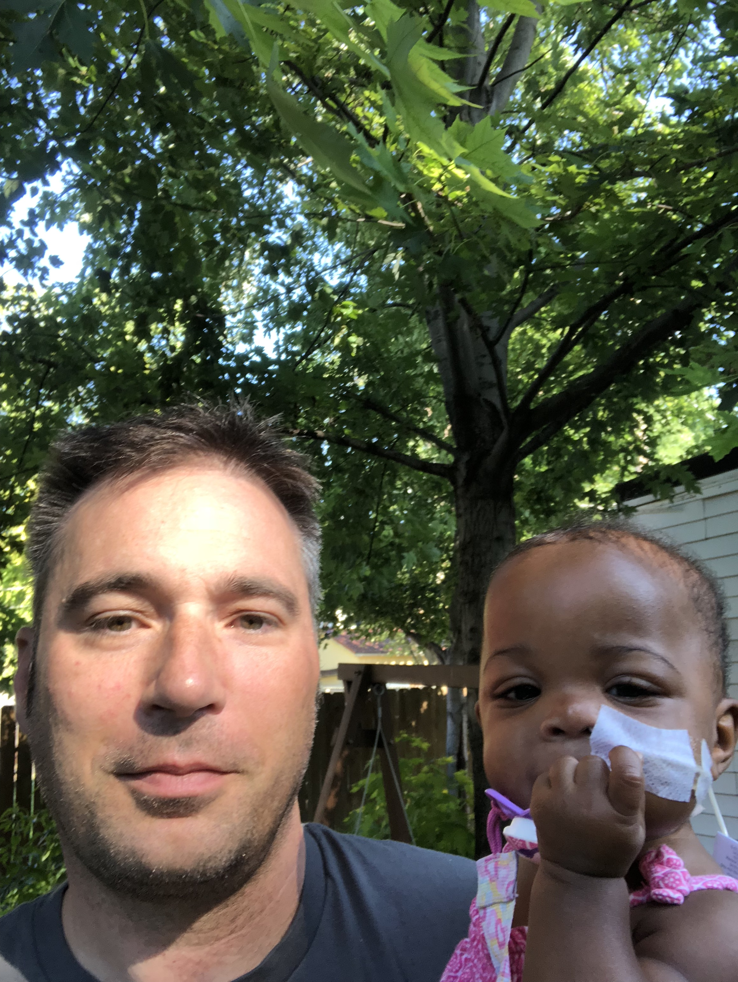
Matt Fisher
3rd year teaching, all at Brown International.
I’ve taught 2nd grade the last 2 years
Father of Eula, a funny and sweet kiddo.
My wife and I moved here from Central Illinois in 2000.
I am a huge supporter of Arsenal FC!!!

Slide 5
What is Departmentalization?
This year at Brown grades 1-5 have learning communities in which a pair of teachers will share two groups of students and teach specific subject areas. That being said please know that your child will have a homeroom teacher, which is your main point of contact.
Here are some of the benefits……..
✔ Teachers can efficiently address academic needs
Departmentalization allows us to very quickly identify student needs and develop specialized intervention and enrichment options.
✔ Time to focus on passions and strengths
This is a new opportunity that enables us to focus on student interests in order to create independent learners
✔ More time for creative, hands-on learning
Departmentalization sets aside time for each subject, and allows us more time to plan hands-on activities.
✔ Students benefit from different teaching styles
This new model gives kids the opportunity to work with multiple teachers each day—and gives teachers the opportunity to work with a range of students.

Slide 6
Mr. Fisher’s Homeroom Schedule
8:55-9 Arrival/ Homeroom
9-9:15 Morning Meeting
9:15-9:30 # corner
9:30-10:15 Social Studies/ Science
10:15-10:30 Recess/ Snack
10:30-11: 35 Math
SWITCH TO MRS. HAMLIN’S CLASSROOM
11:40- 12:25 EL Literacy – Whole Group
12:25-1:10 Recess/ Lunch
1:15- 1:25 Mind Up/ Read Aloud
1:25-1:45 EL Literacy – Whole Group
1:45-2:45 Small Group Literacy/Guided Reading Centers
2:55-3:40 Specials
3:45- Dismissal

Slide 7
Mrs. Hamlin’s Homeroom Schedule
8:55-9 Arrival/ Homeroom
9-9:15 Morning Meeting
9:15-10:15 EL Literacy – Whole Group
10:15-10:30 Recess/ Snack
10:30-11: 35 Small Group Literacy/Guided Reading Centers
SWITCH TO MR. FISHER’S CLASSROOM
11:40- 12:25 Science/ Social Studies
12:25-1:10 Recess/ Lunch
1:15- 1:25 Mind Up/ Read Aloud
1:25-1:40 # corner
1:40-2:45 Math
2:55-3:40 Specials
3:45- Dismissal

Slide 8
Classroom Management “Building a Strong Community”
Essential Agreements
Jar Party
Clip Chart
Refocusing
PRIDE squares
Golden tickets

Slide 9
Homework
Homework should be 20-25 minutes a night of reading
Family reading or reading to younger siblings
counts; don’t stress about the level of reading, just
read!
All students should meet their AR goal each trimester (books at home can be quizzed on).
**see handout on overdrive login**
Math Home Connections & Social Studies /Science projects may come home on an as-needed basis.
It should always be review—no new concepts introduced.
Visit our weebly site for resources/websites used in class
www.brown215.weebly.com

Slide 10
PARCC/CMAS Testing Dates
March/April
Please do not take vacation/schedule appointments during this time (it’s usually the week BEFORE spring break and the week AFTER spring bread)

Slide 11
3rd Grade Curriculum
Please pick up a packet for more detailed information!

Slide 12
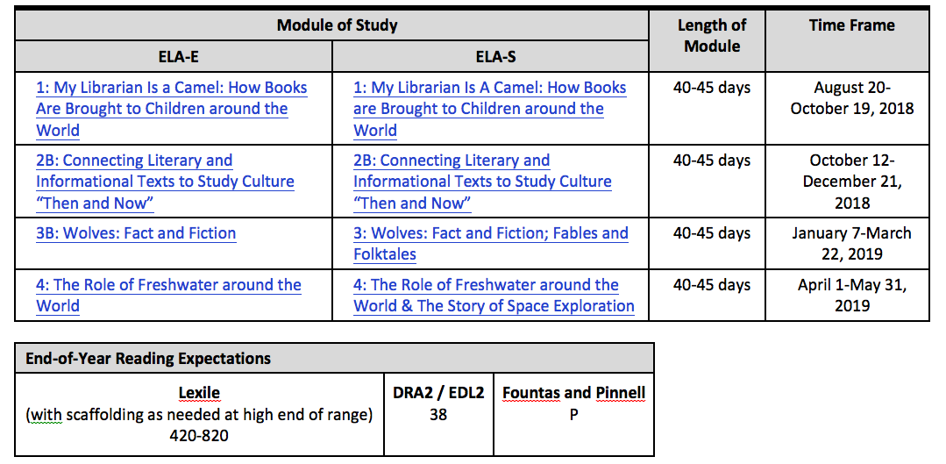
Literacy
Expeditionary Learning
**See Handout**
iStation testing/running records every month

Slide 13
Math

Slide 14
PYP Units of Inquiry For each of the units, we always love for the kids to take action. Feel free to come up with your own ideas as a family and have your child share them with their teacher.
Who We Are – focusing on what makes a hero
How We Express Ourselves – focusing on poetry, figurative language and also on how people express themselves through creative expression.
Where We Are in Place and Time – focusing on ancient history
Sharing the Planet – focusing on food chains and life cycles
How the World Works – focusing on our changing Earth
How We Organize Ourselves – focusing on economics

Slide 15
Accelerated Reader
STAR TESTING
Goals have been made!
Unfortunately, students are not allowed to quiz at home; however, if they finish a book at home, let us know and they can quiz first thing.
You can log on to AR (your child should know his/her log-in information) at home and check your child’s progress (see handout)
AR party at the end of each trimester

Slide 16
Other Information:
Snacks – healthy, easy to eat snacks
Water Bottles
School Visitors – MUST sign in at office
Attendance – It’s important to be here every day!!
Volunteering –you will be contacted by your child’s teacher
Room Parents – PTA sign up
After school pick-up – if after 3:55 pm, pick up child in the office
Birthdays – NO treats/goodies
Can bring a baby/toddler picture to show everyone
We will sing at the end of the day
Field Trip & Supply Money Reminder

Slide 17
Contact Information Together we can partner up to make a difference in your child’s life
Whitney_hamlin@dpsk12.org
Matthew_fisher@dpsk12.org
Office Main Line - 720-424-9250
Bloomz code: C6G4EZ

Slide 18
Questions:

